Slide 1
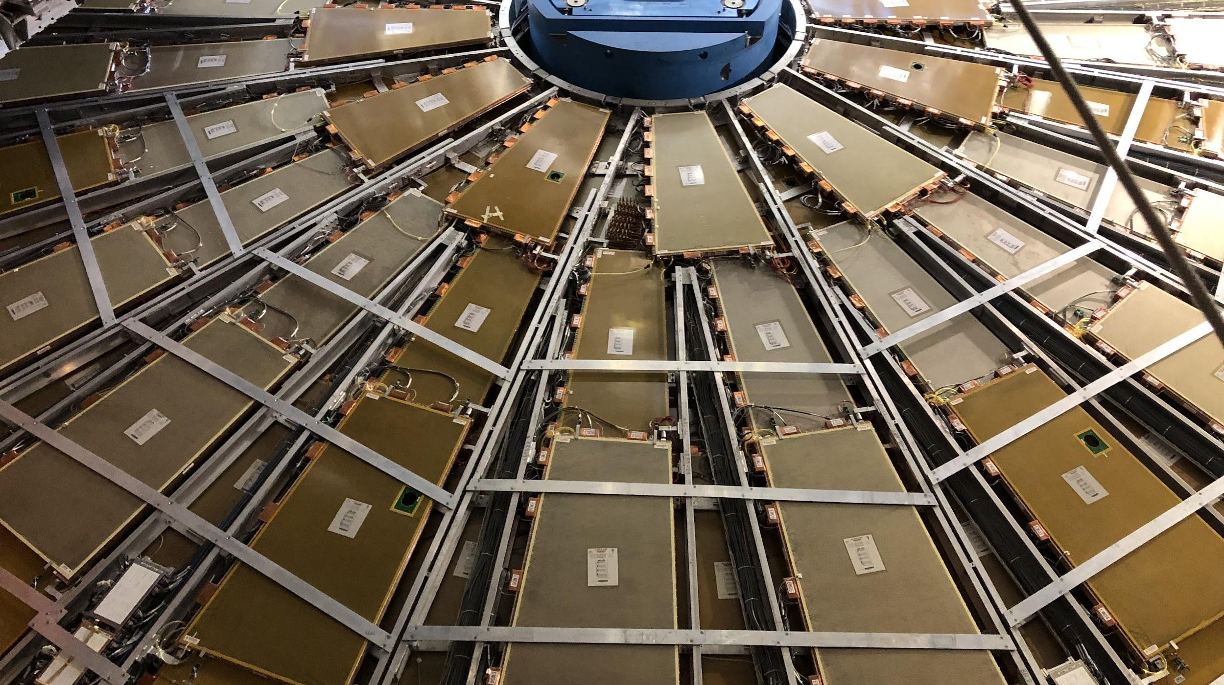

Maintenance Weekly
TileCal Op Meeting, 2 December 2021
Irakli Minashvili, Chris Thomas, Dawit Belayneh, Katie Hughes

Slide 2
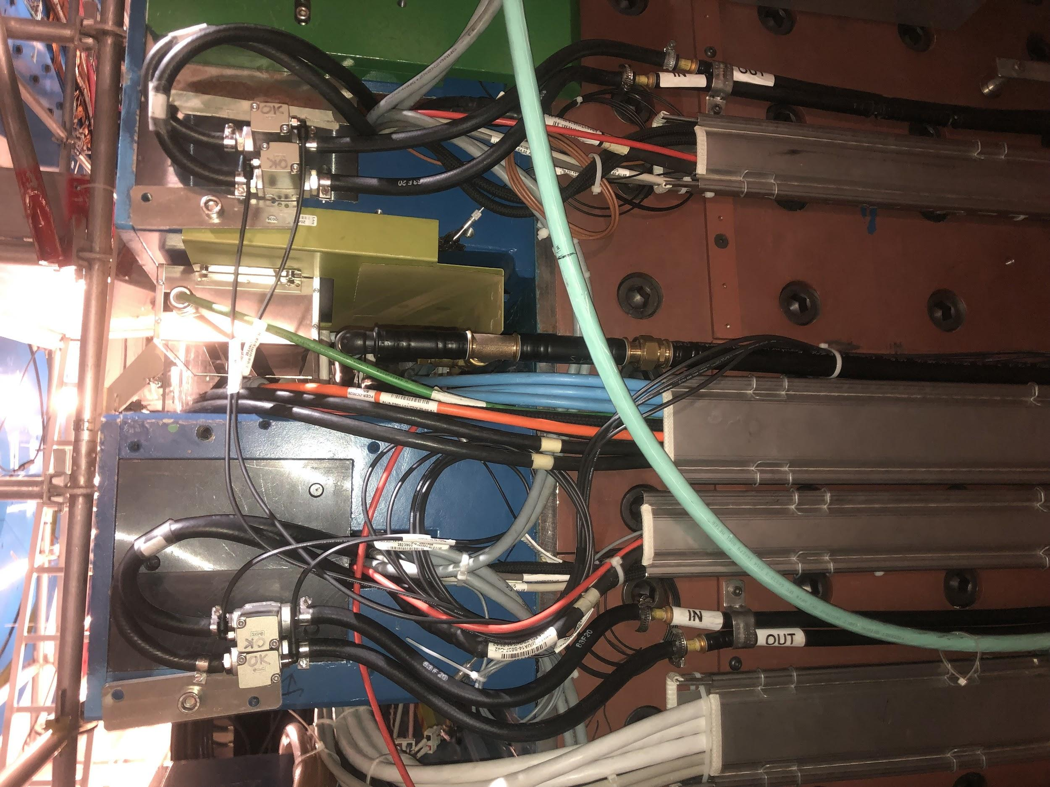
Isolation Valves Update

Slide 3
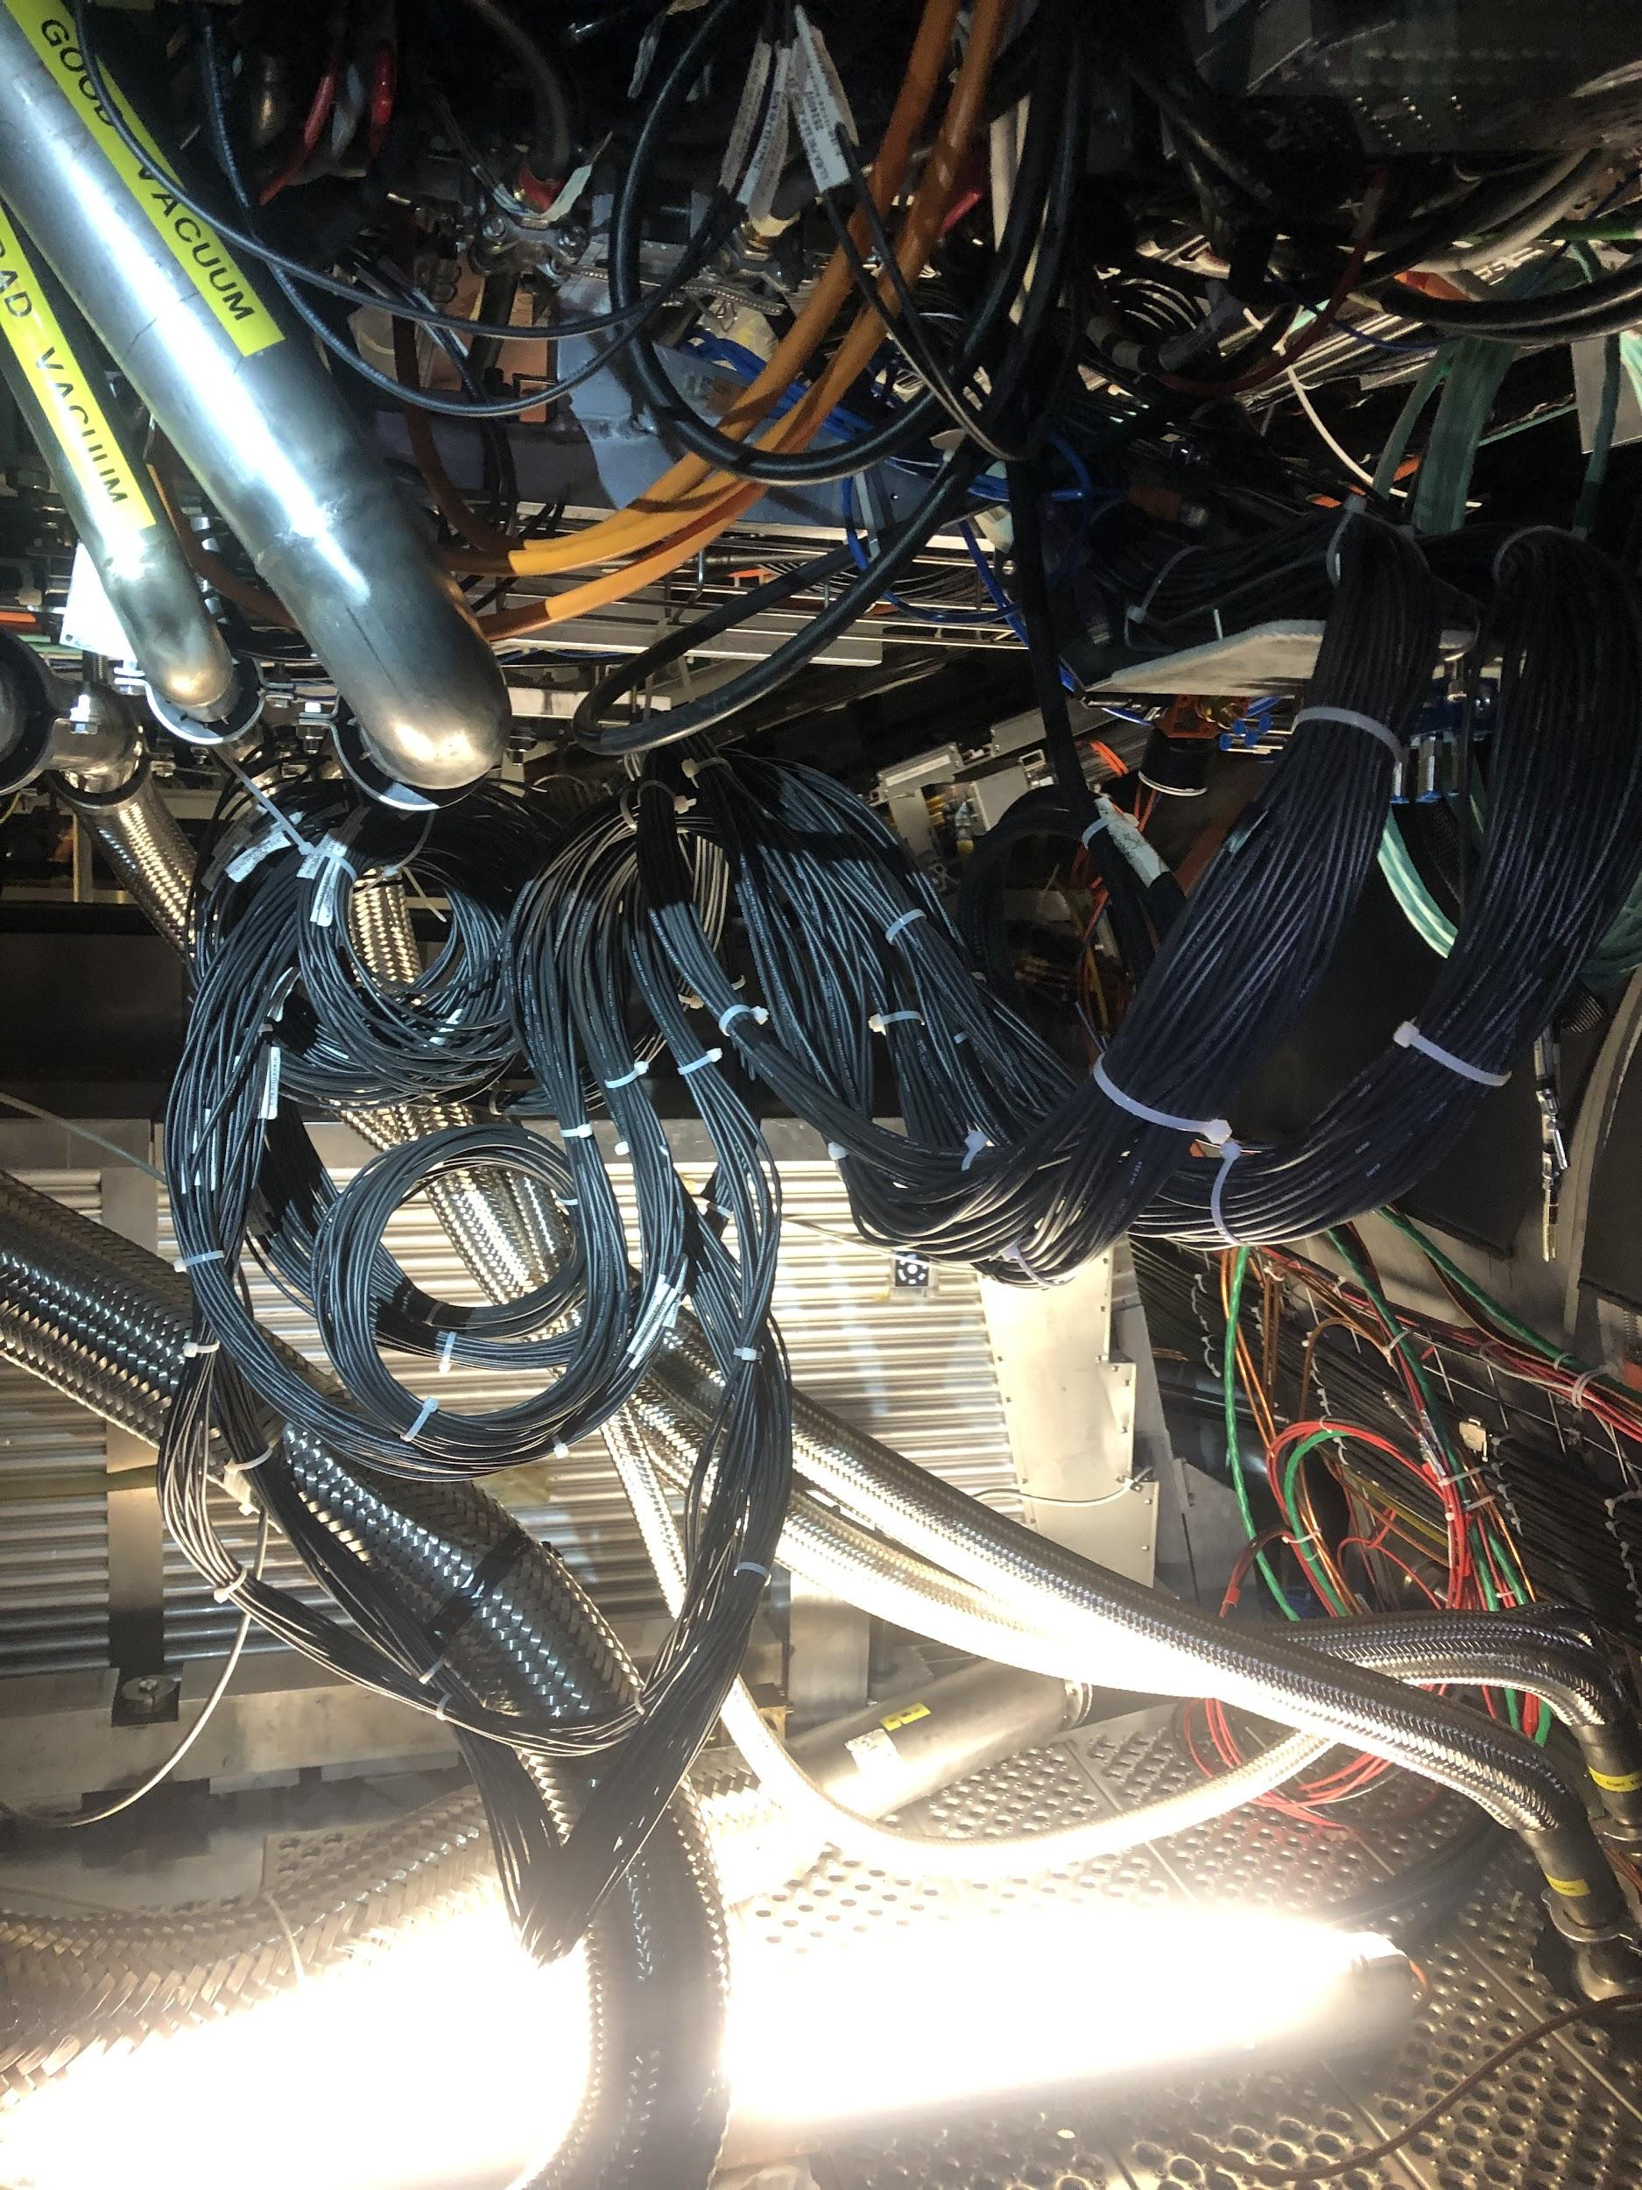
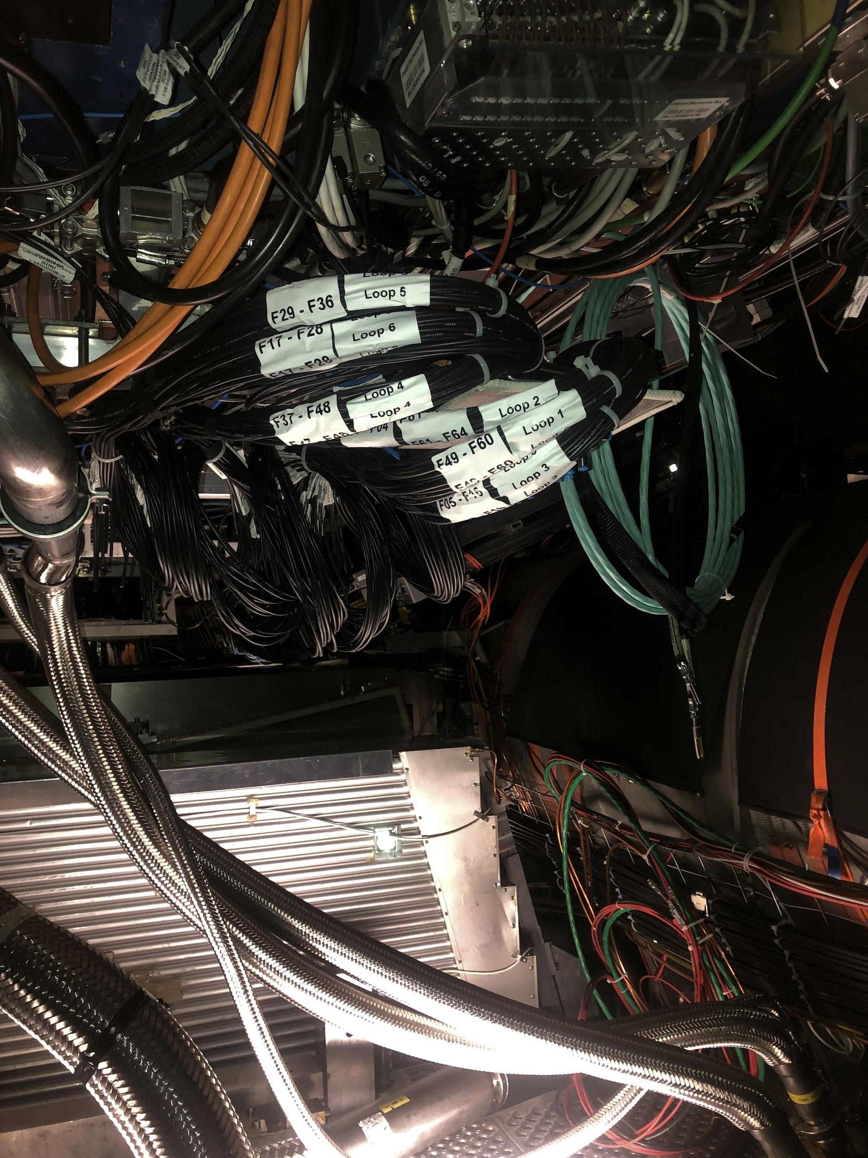
EBA Before and After

Slide 4
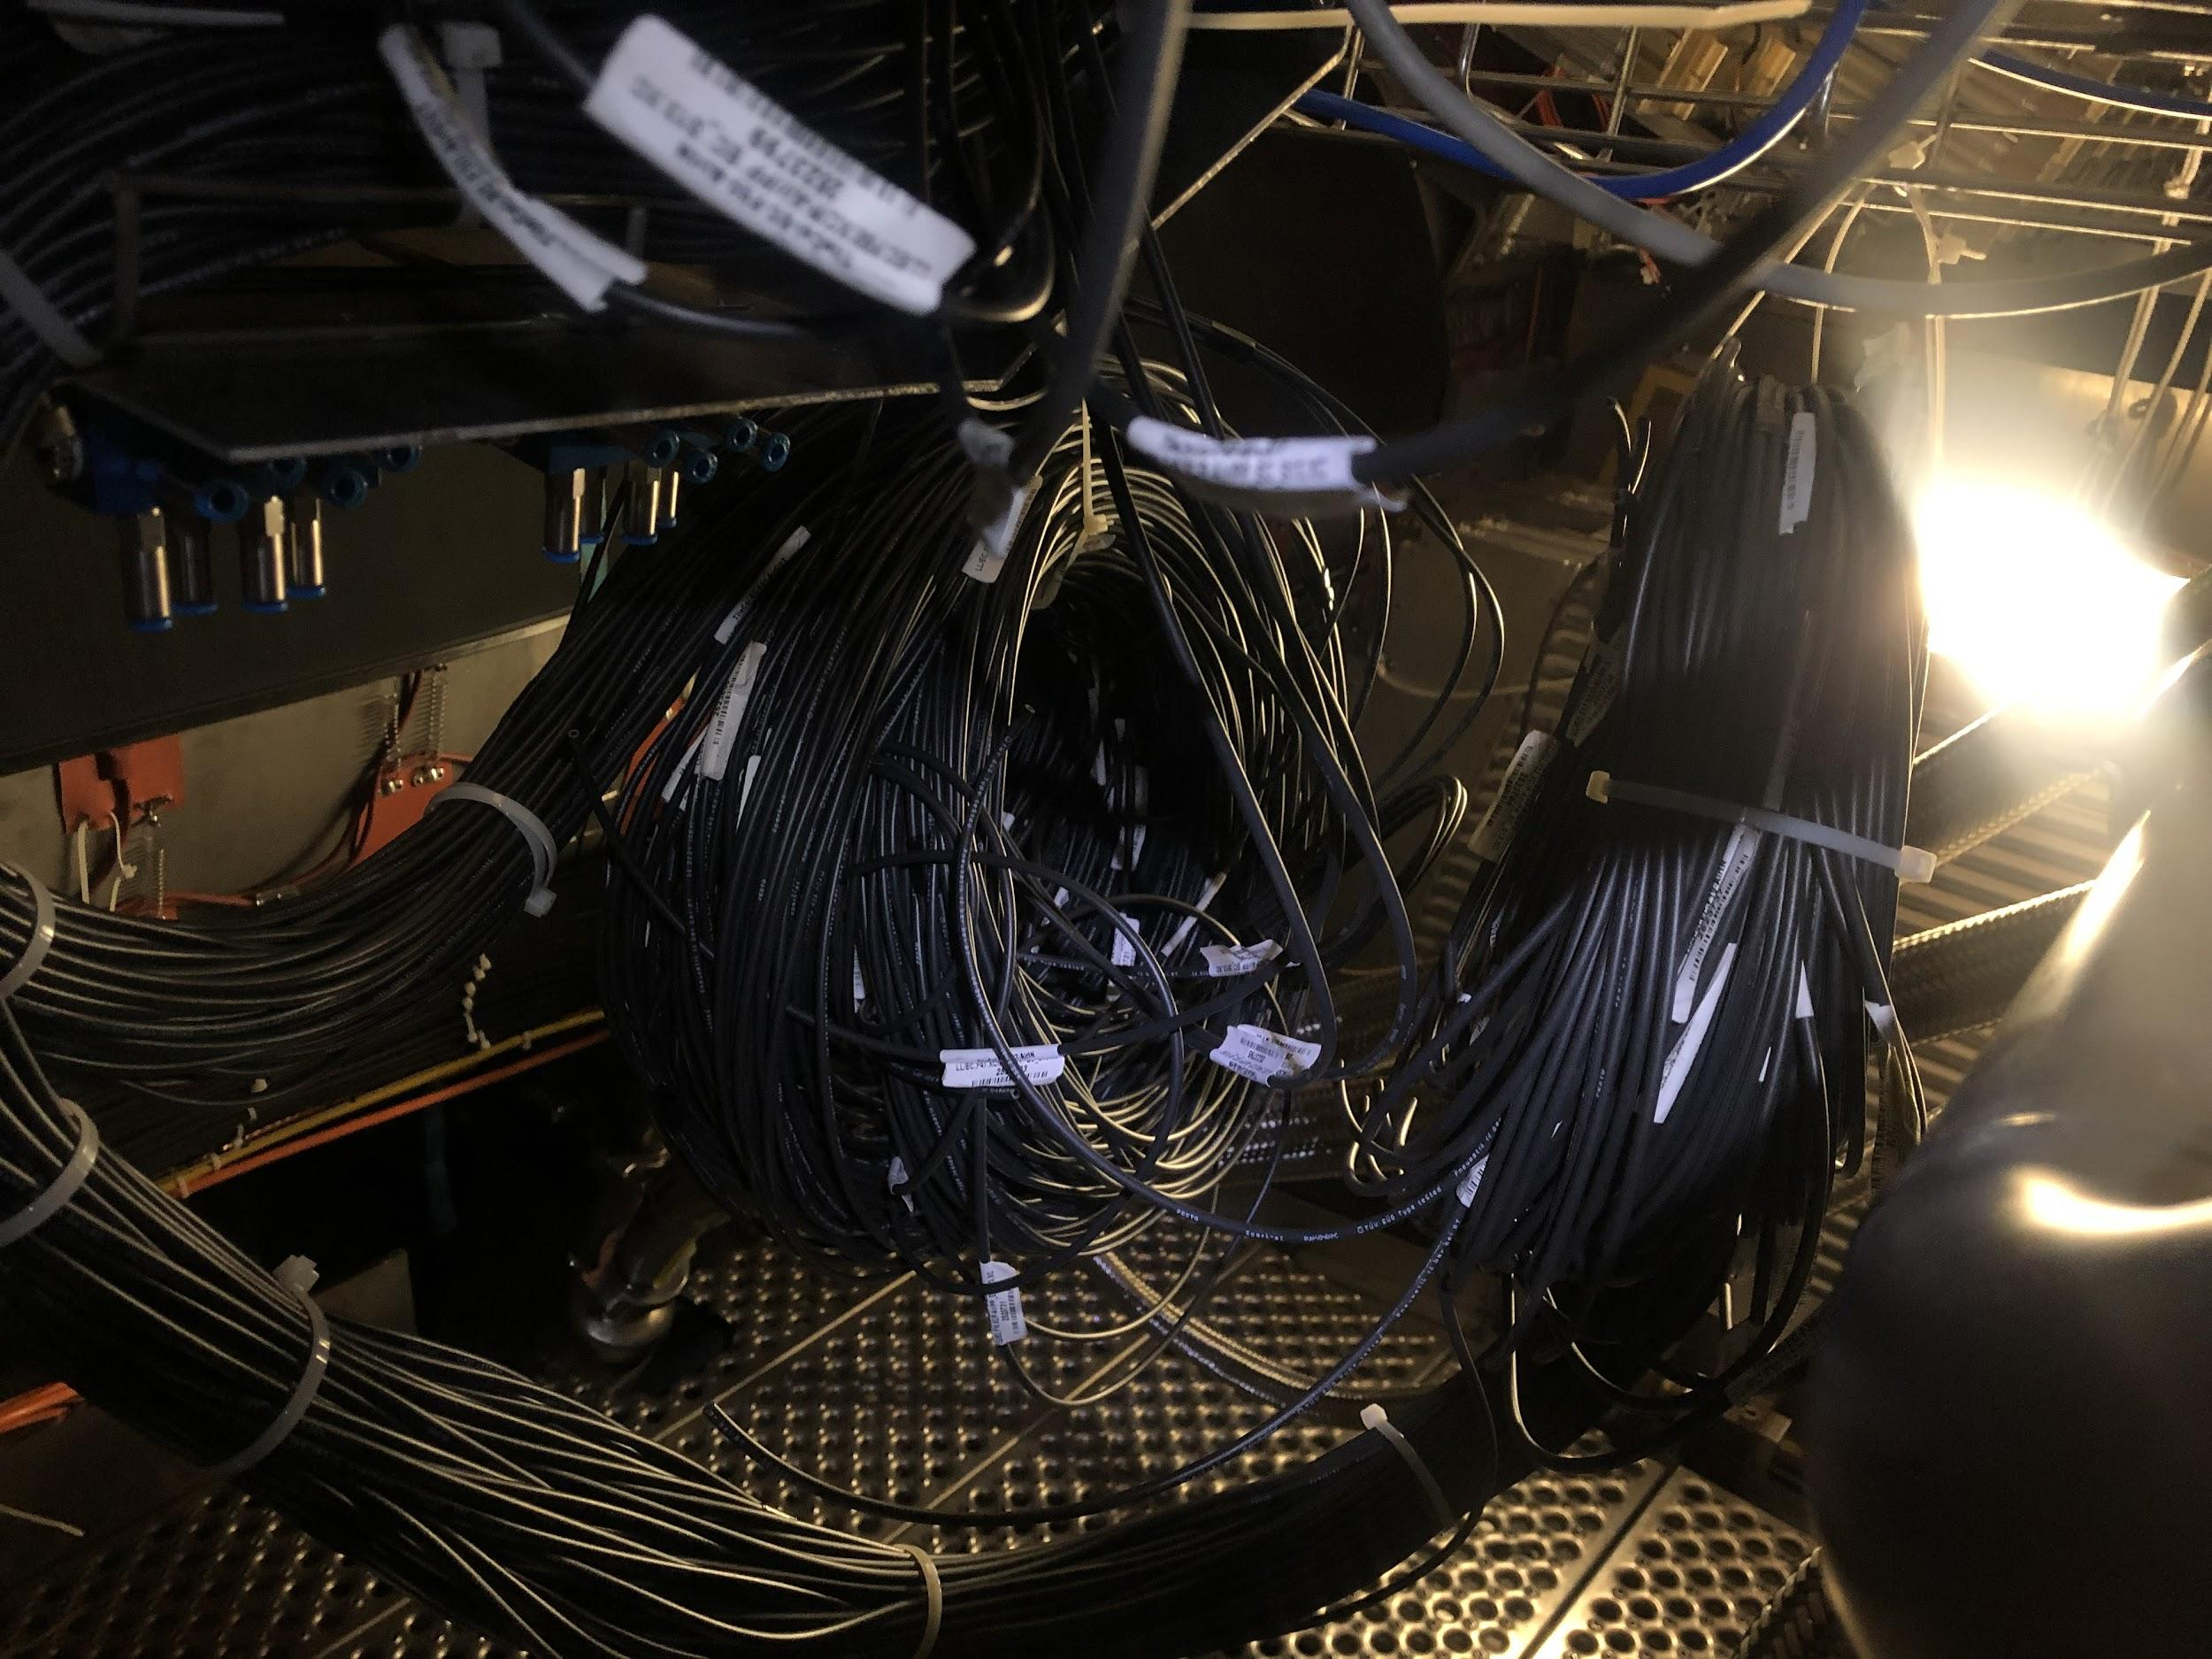
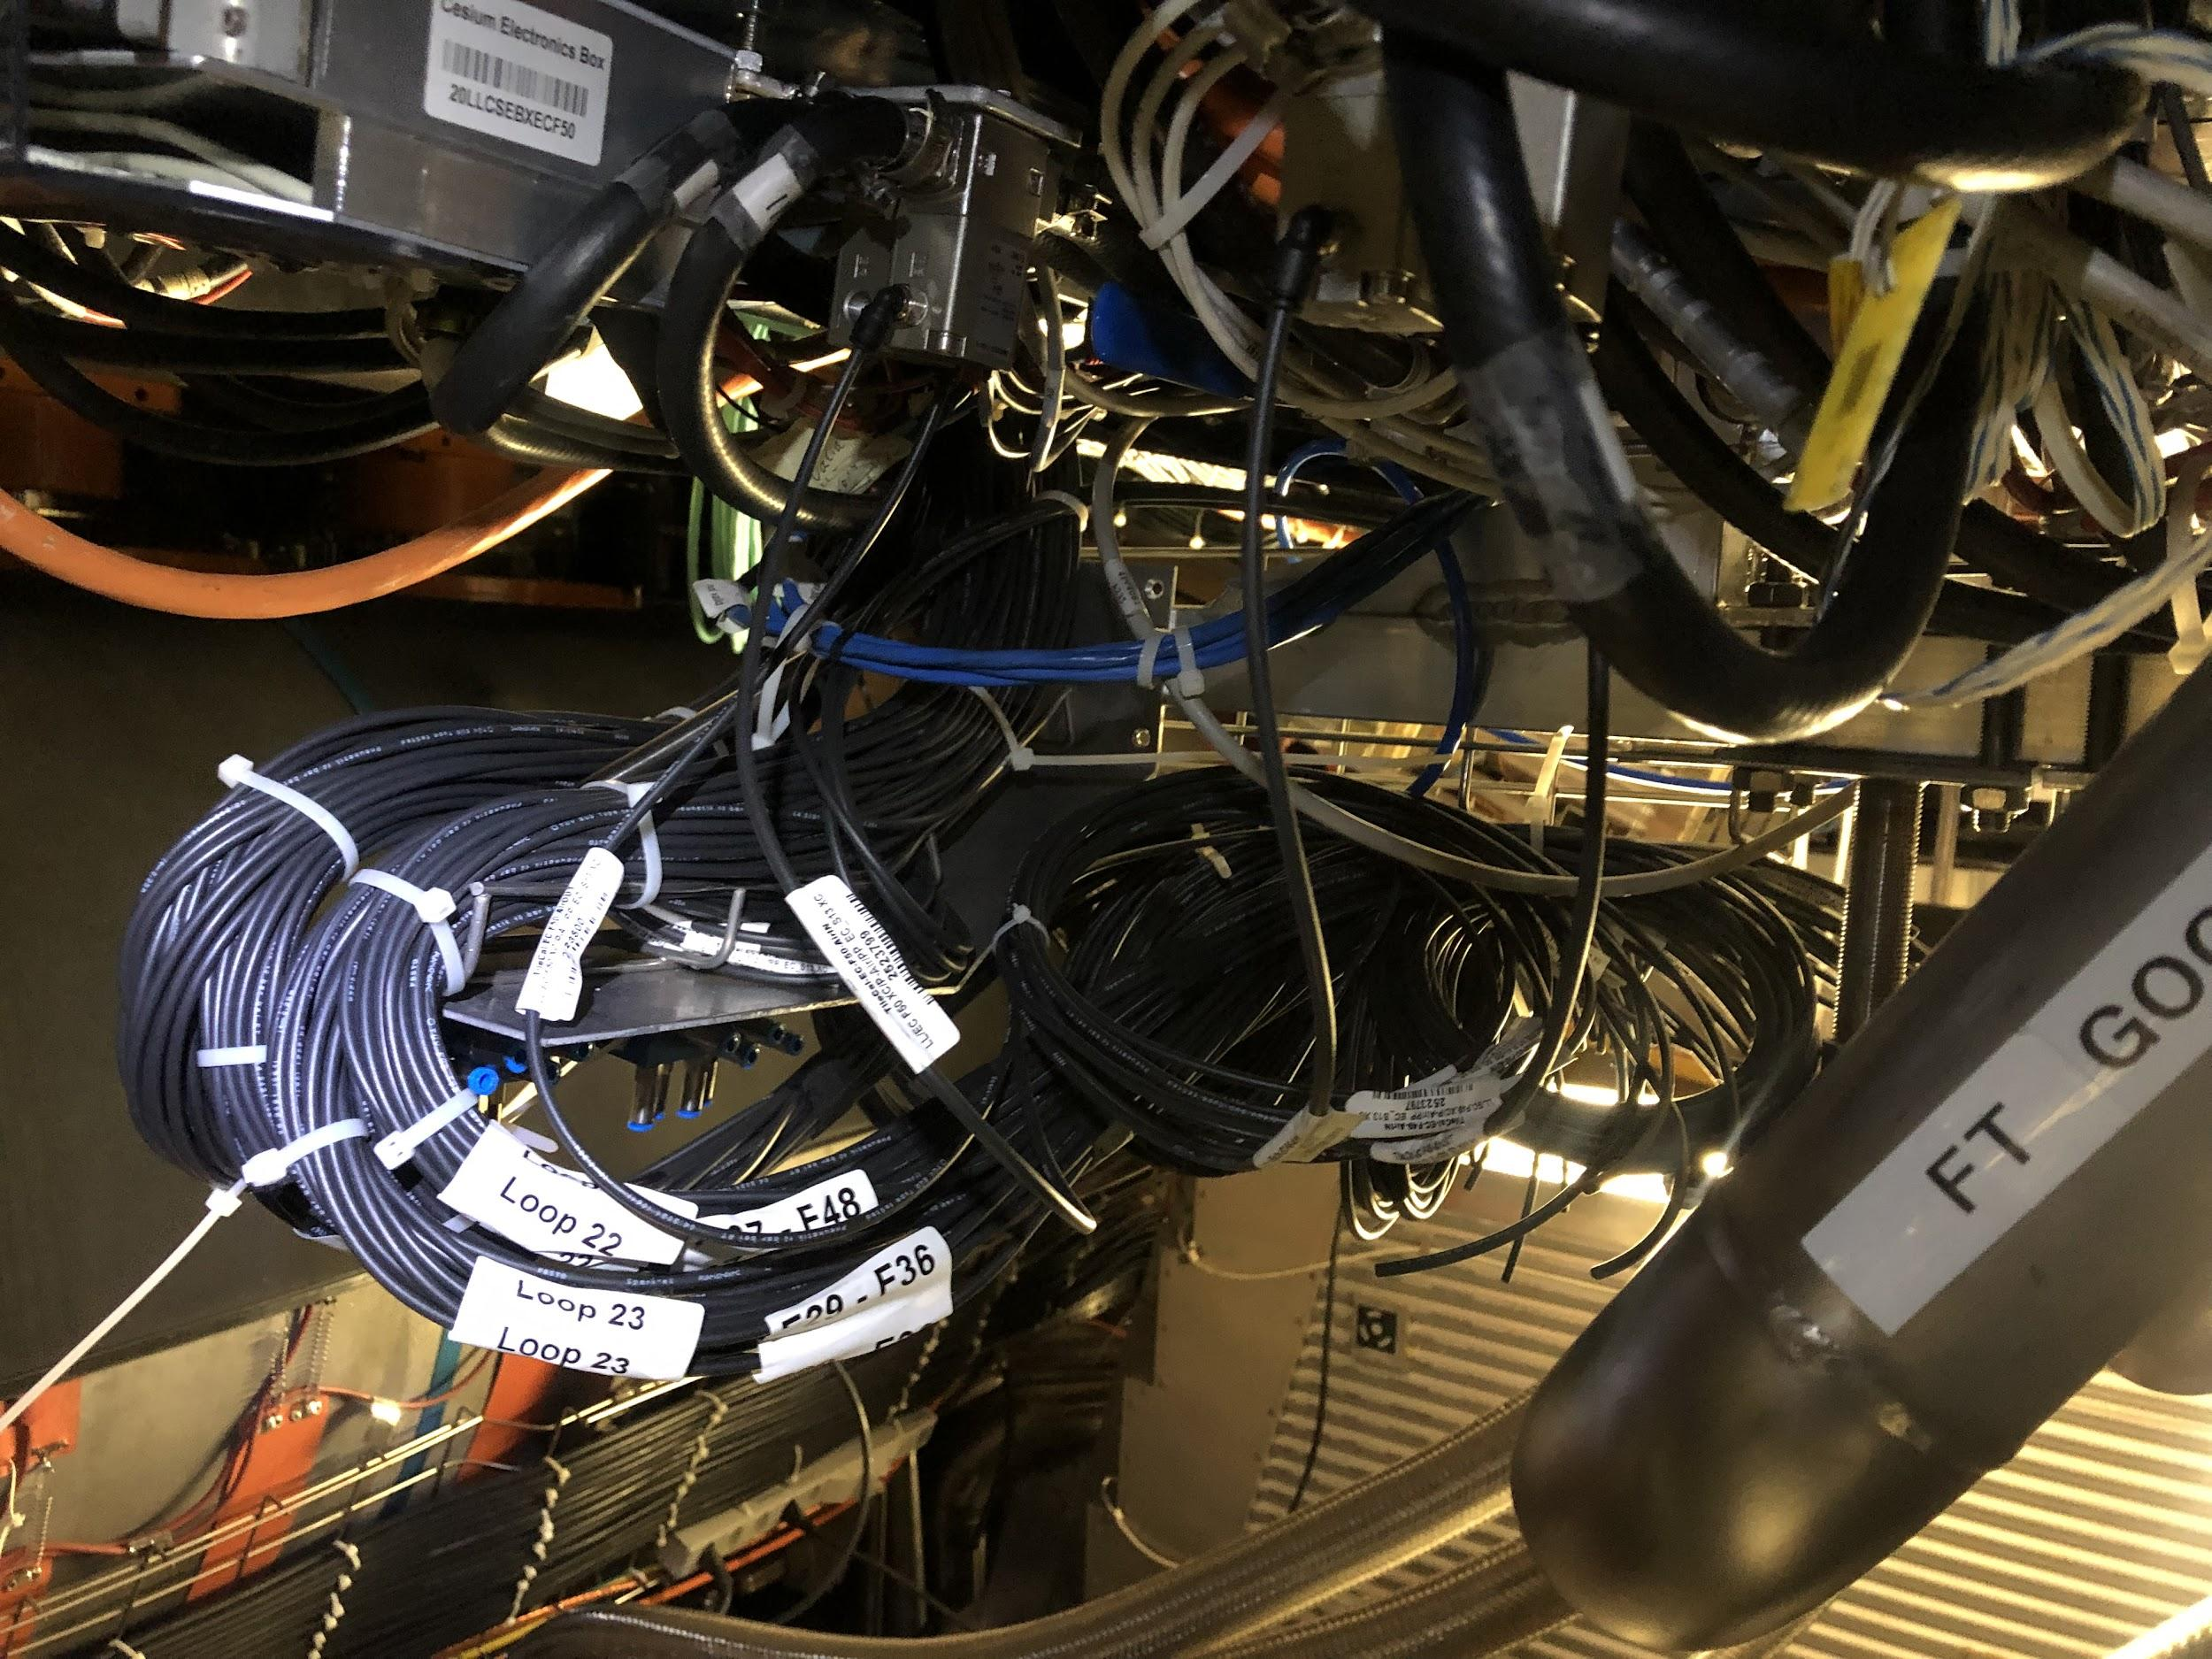
EBC Before and After

